Slide 1

DATA*6500 - Analysis of Spatial-Temporal Data
Urban Sprawl using Land Cover Data
of Canada
Prepared by : Gunpreet Singh, Gurleen Pelia, Mariyam Ahmed

Slide 2
CONTENT
Motivation
KDE
Introduction & Objective
Future Work
Data Sources
Conclusions
EDA
References

Slide 3
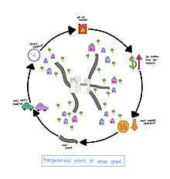
Motivation
Current scenario :
In Canada, % of urban sprawl took place over last 25 years - 77%
Specifically in Ontario , it is 18 %
What motivated us ?
Something which is increasing at such a high rate, must be explored better.
Population of Canada increased by 14.9% from over last decade i.e. 2014 to 2024
Therefore, the urban sprawl over this period is ~ 34%
Expected population to increase in coming 5 years - 1.4%
Hence, we would need more -
Healthcare & Childcare
Roads, Bridges & Transit
Education & Recreation
And Community buildings

Slide 4

Introduction & Objective
What is Urban Sprawl ?
Why we are using land cover data to explore urban sprawl ?
What is the objective of this project ?
Urban sprawl is the spread of city development into rural areas, creating low-density neighborhoods and requiring more cars and infrastructure. This often leads to increased traffic, pollution, and loss of natural habitats​
Land cover data classifies areas into different kinds of land types. By tracking the change in classification of vegetation/ farmland to built-up, urban sprawl aptterns can be detected and studied
To do analysis about urban sprawl took place in past 1 decade
What future we expect
We are only considering 1 city because highest development seen there over 10 years.

Slide 5


Data Sources
Primary Data Sources :
Source Name: Canada Centre for Remote Sensing (CCRS) Land Cover Map
Description: This dataset provides detailed land cover information for Canada at a 30 m spatial resolution and covers 3 years :
Landcover of Canada 2010
Landcover of Canada 2015
Landcover of Canada 2020
Secondary Data Sources :
Source Name: Ontario Builds: key infrastructure projects
Description: The dataset provides Ontario’s historic infrastructure plan and leading projects that strengthen our communities and economy such as :-
hospitals
transit systems and roads
education centres
community buildings and bridges.

Slide 6
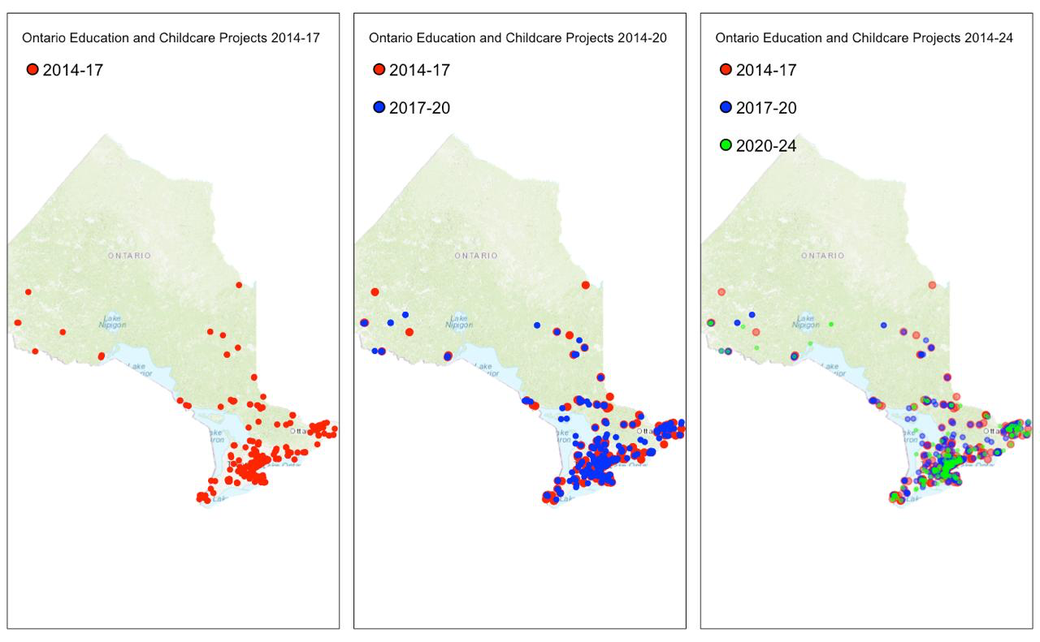

Slide 7
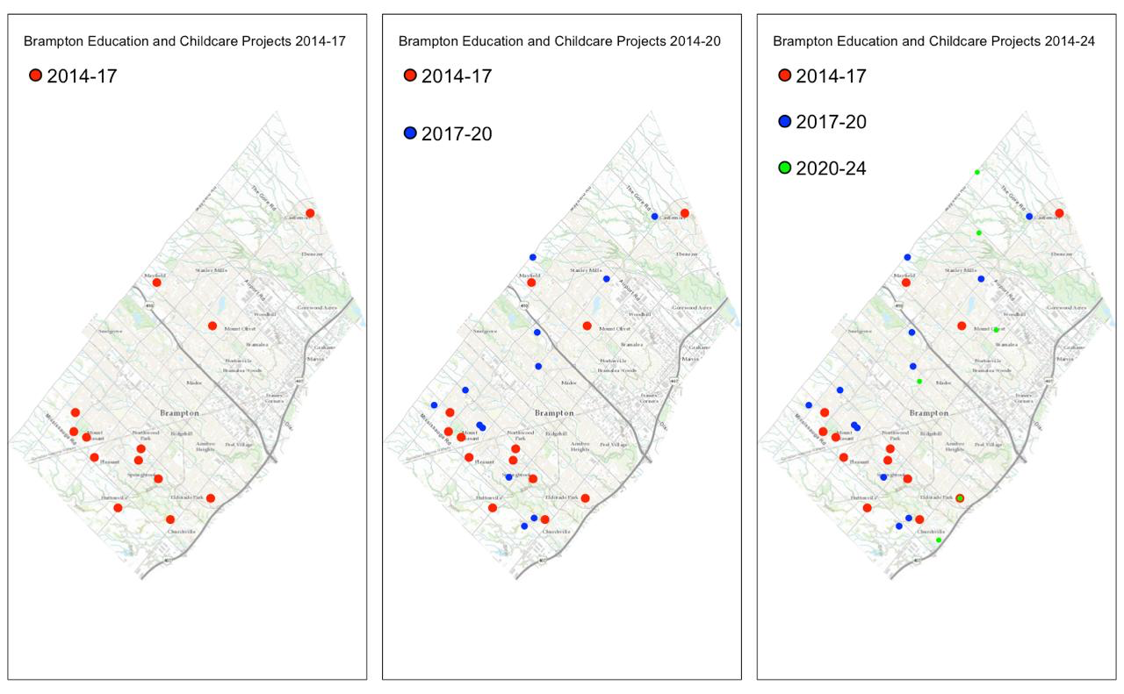

Slide 8
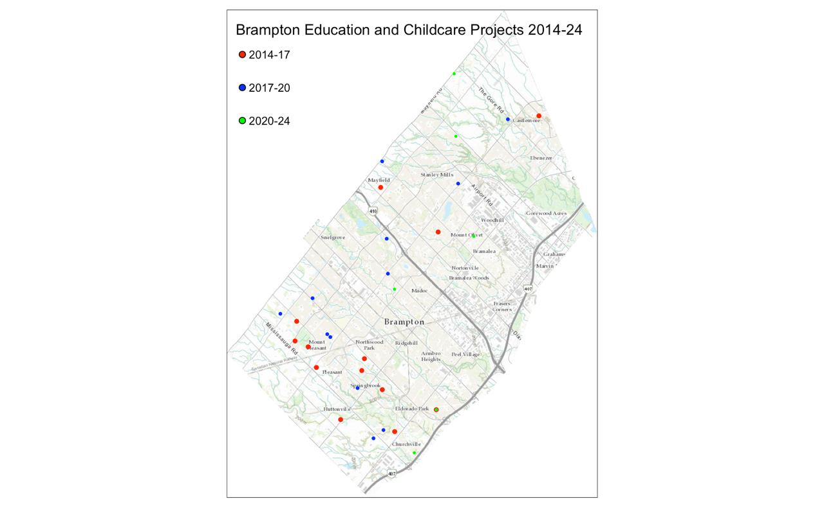

Slide 9
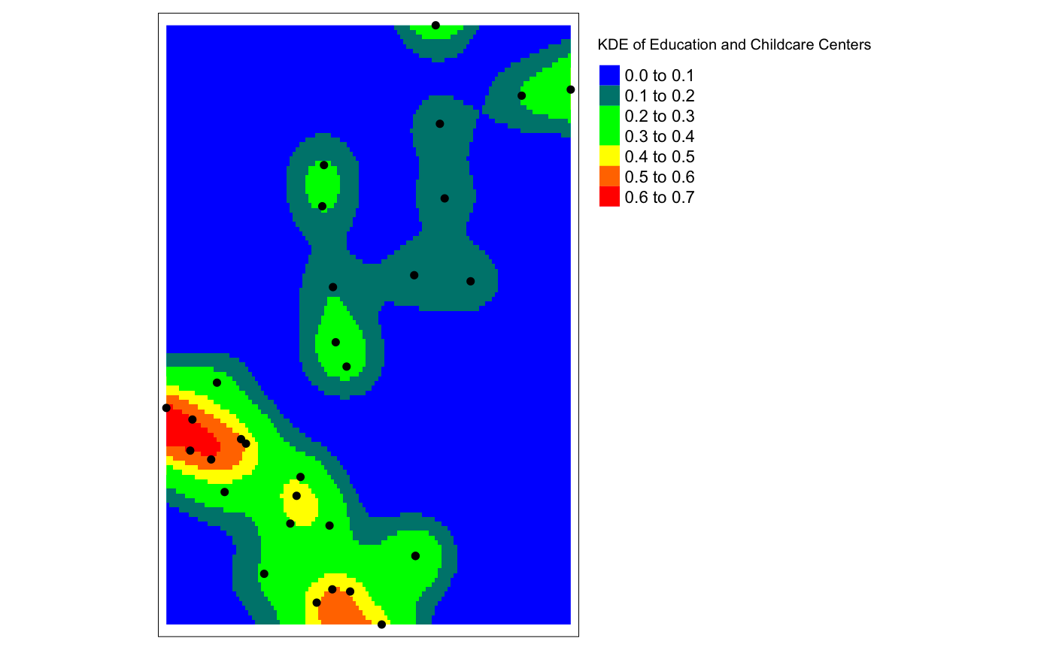

Slide 10
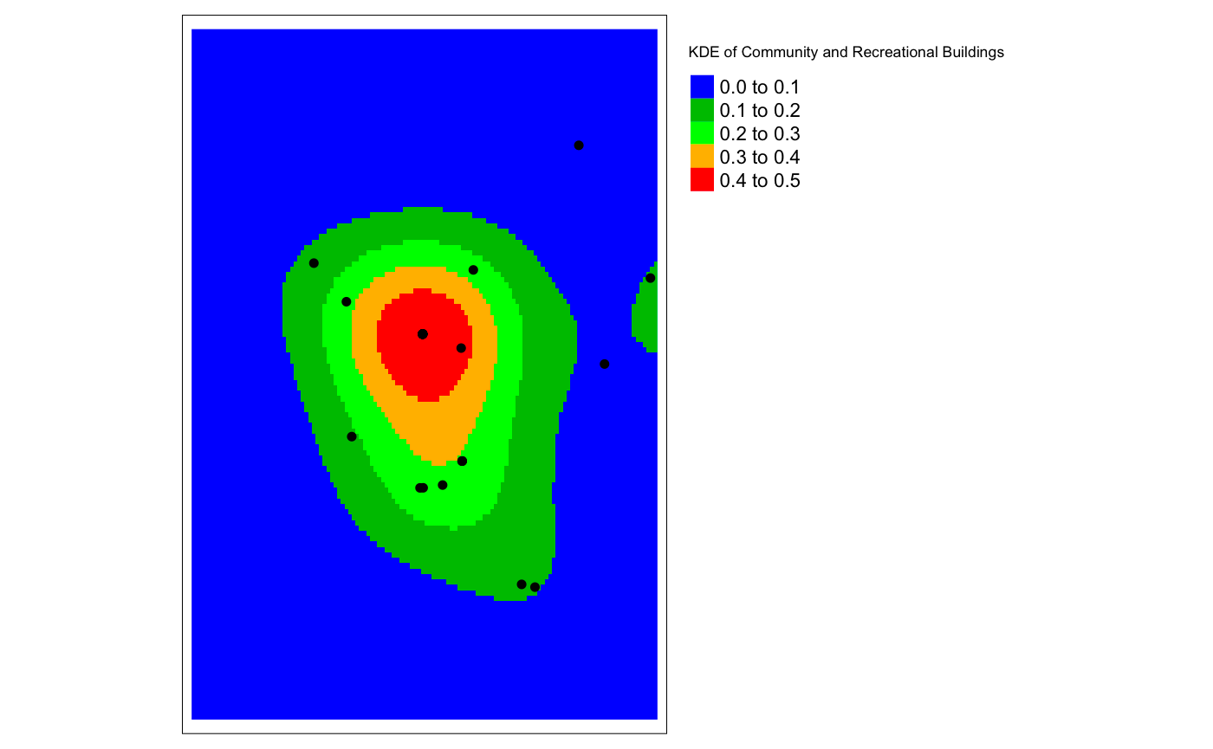

Slide 11
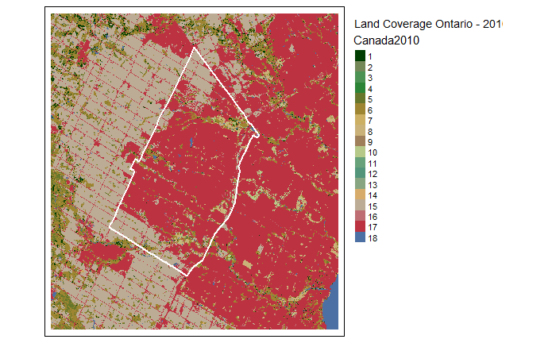


Exploratory Data Analysis - land cover over time
2010 2015 2020

Slide 12
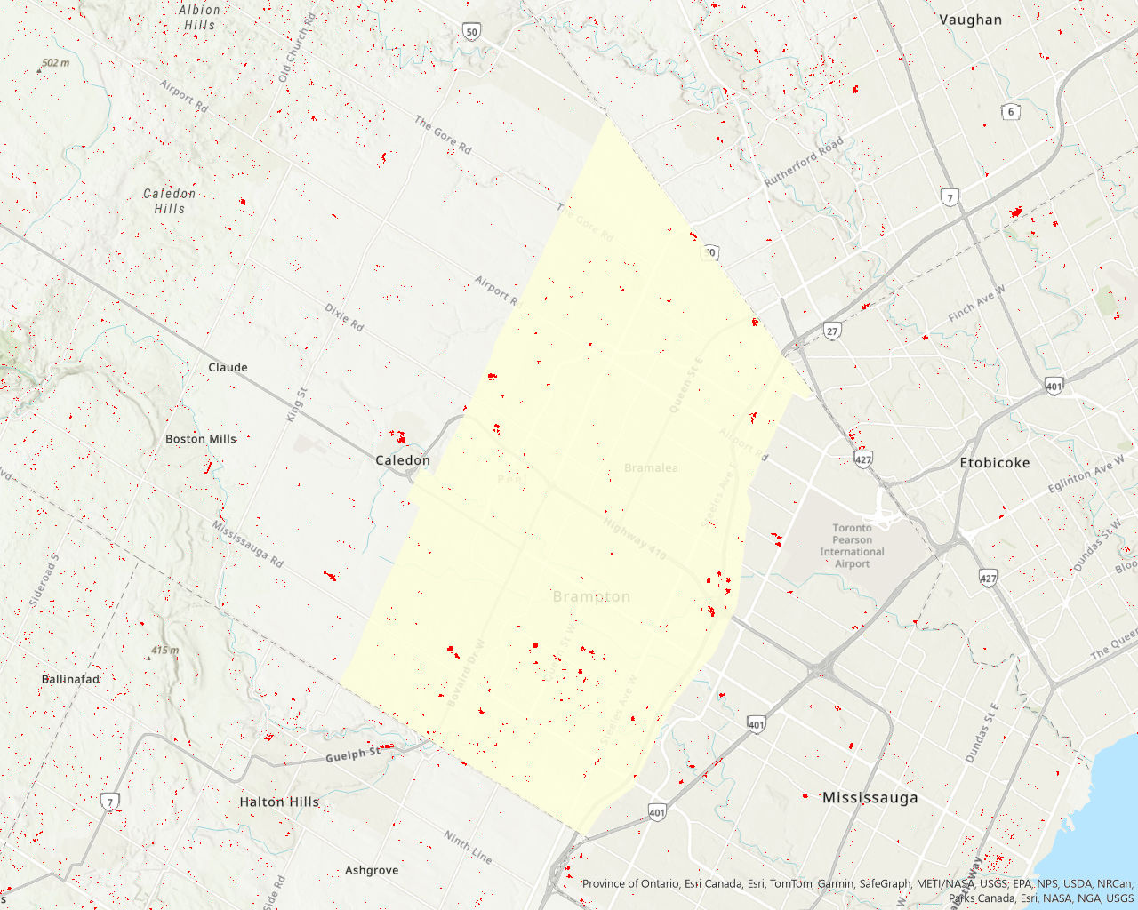
Highlighting Urban Sprawl
Calculate the difference between 2010 land cover data and 2020 land cover data
Highlight cells that have changed from any other category to ‘urban and built-up)

Slide 13
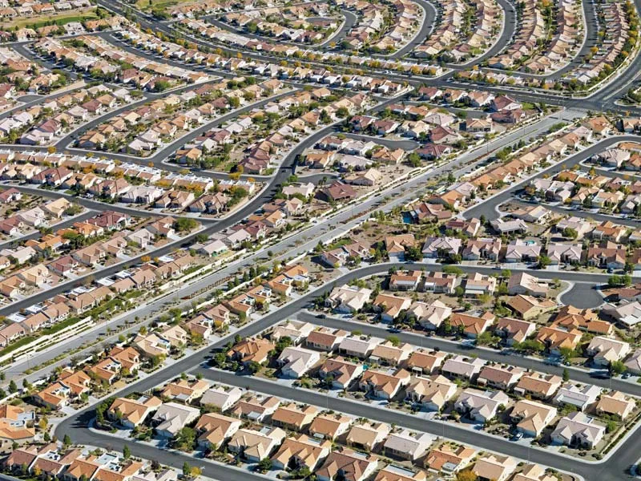
Future Work
Convert data:
Classify cells as ‘changed to urban’ or ‘not changed to urban’ over time
Vectorize raster data and convert cells to a point geometry using the centroid
Find predictors:
Calculate distances from community centers, key infrastructure, schools, etc. points for each point
Incorporate demographic data such as population density
Train a predictive model:
Train a classification model to predict whether an area will experience urbanization (logistic regression, Random Forest).
Since there is a heavy class imbalance, we plan to use oversampling methods (SMOTE)

Slide 14
Conclusion
Urban sprawl is a growing issue as the population and property prices increases.
By implementing a classification model to predict land use chnages, our goal is to understand the factors that contribute to urban sprawl.

Slide 15

References
Shikhar Deep, Akansha Saklani. (2014). “Urban sprawl modeling using cellular automata.” The Egyptian Journal of Remote Sensing and Space Sciences, 17, 179–187. DOI: 10.1016/j.ejrs.2014.07.001.
Mussie G. Tewolde, Pedro Cabral. (2011). “Urban Sprawl Analysis and Modeling in Asmara, Eritrea.” Remote Sens., 3, 2148-2165. DOI: 10.3390/rs3102148.
Parvinnezhad, Davoud, et al. (2021). “A modified spatial entropy for urban sprawl assessment.” Geo- carto International, 36(16), 1804-1819.
Zeng, Chen, et al. (2015). “Characterization and spatial modeling of urban sprawl in the Wuhan Metropolitan Area, China.” International Journal of Applied Earth Observation and Geoinformation, 34, 10-24.
Chen, Danling, et al. (2021). “How urban sprawl influences eco-environmental quality: Empirical research in China by using the Spatial Durbin model.” Ecological Indicators, 131, 108113.
Baqa, Muhammad Fahad, et al. (2021). “Monitoring and modeling the patterns and trends of urban growth using urban sprawl matrix and CA-Markov model: A case study of Karachi, Pakistan.” Land, 10(7), 700.

Slide 16
Thank you
Happy to answer your queries :)

